Slide 1
Stock Price Prediction
Shashwat Sinha & Himanshu Kr. Singh
2006086 & 2006023
T&T Lab
IT - 2

Slide 2
Project Objective and Description
Objective: To Predict Stock Price
Methodology: Using Random Forest We predict Stock Prices

Slide 3
Tools and Dataset Exploration
Dataset: NSE_TATAGLOBAL.csv
Python libraries: Numpy, sklearn, Matplot, Pandas.
Data constraints:-
Data is Till 2018

Slide 4
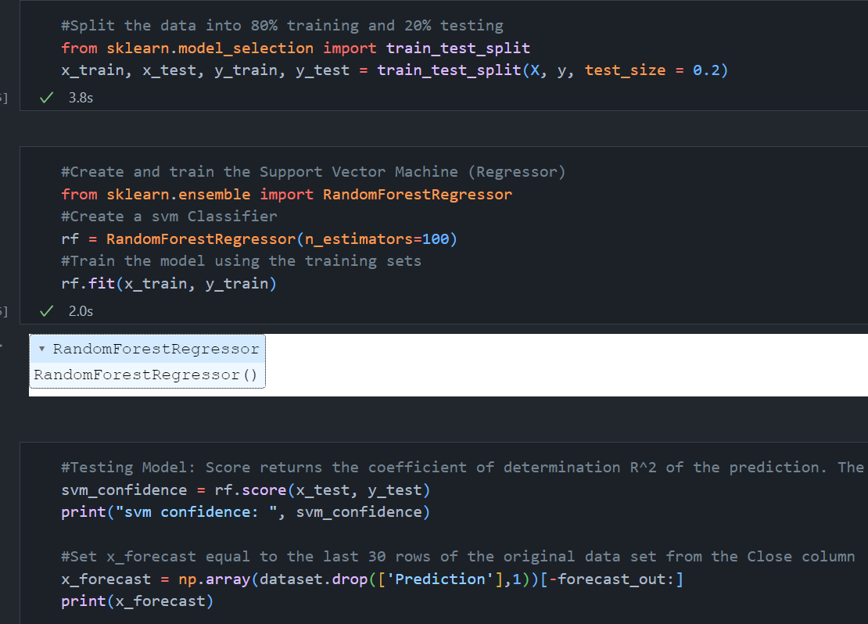
Random Forest Function Layout code

Slide 5
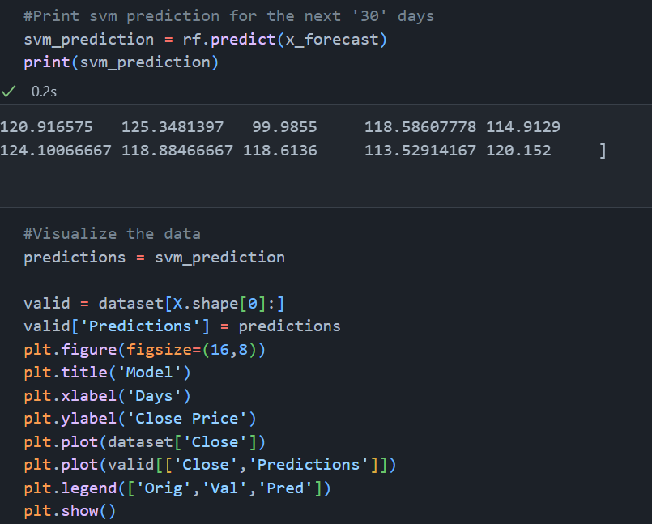
Application Code

Slide 6
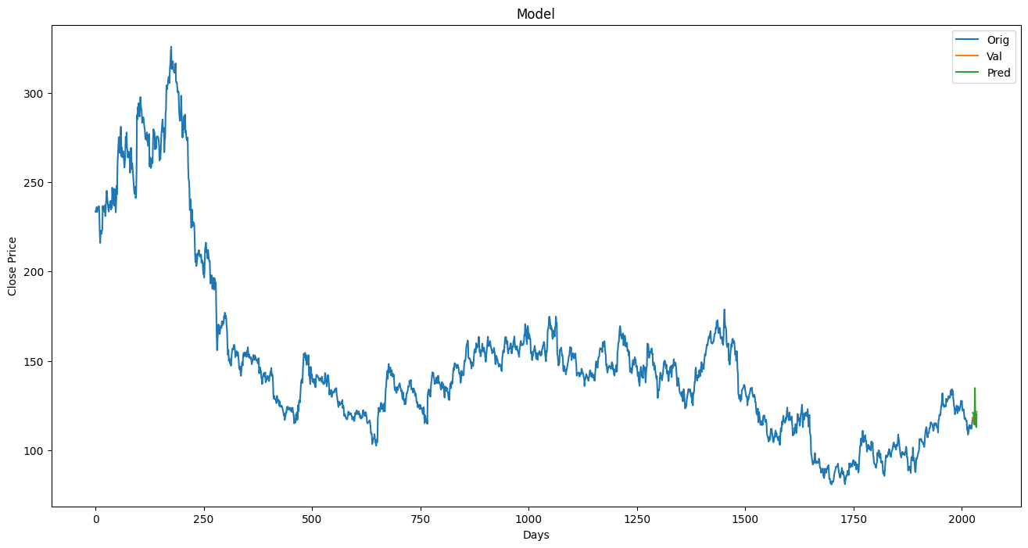
Output

Slide 7
Thank You

